Slide 1
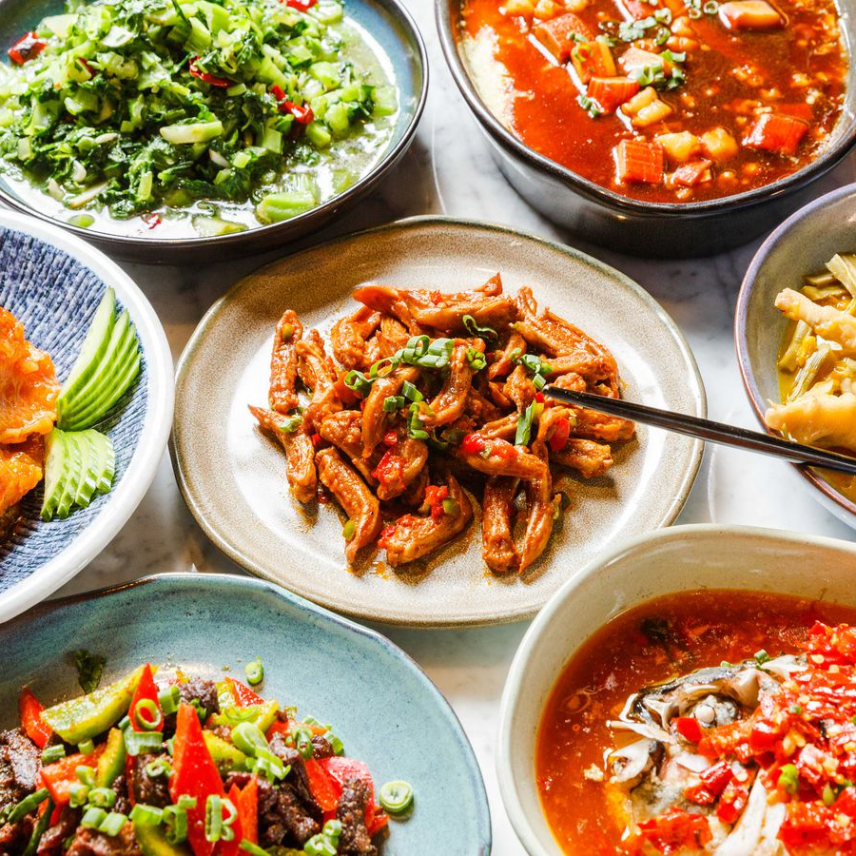
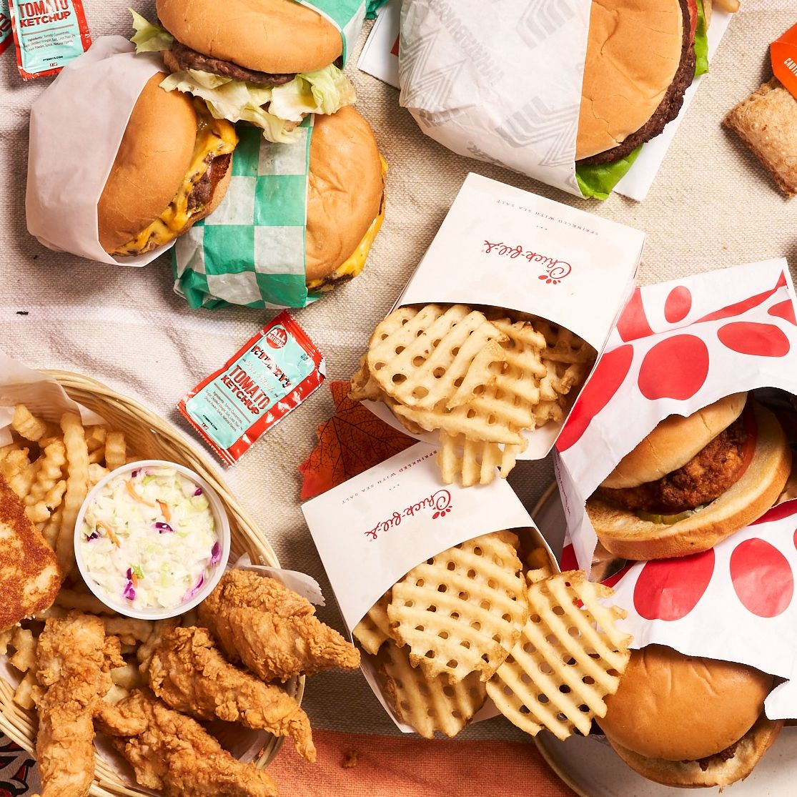
Opening a new restaurant in Toronto area?
an exploratory study of Toronto restaurants

Slide 2
two datasets
Restaurant dataset from Kaggle.com
Data retrieved from Foursquare API.

Slide 3
methodology
Explore all the restaurants from the Kaggle dataset
Explore all the Chinese restaurants from Kaggle dataset
Use Foursquare API to obtain restaurants within 500-meter radius of Chinese restaurants

Slide 4
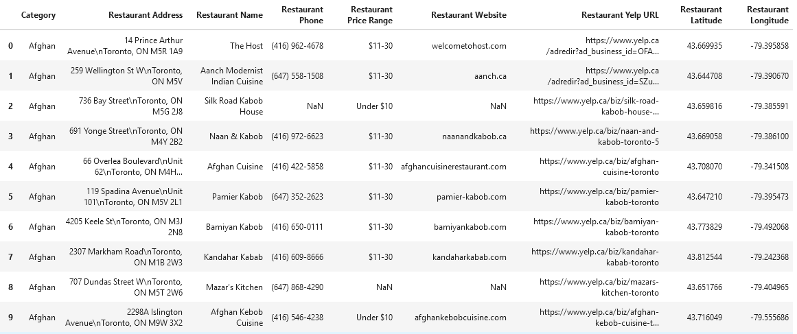
Kaggle dataset

Slide 5
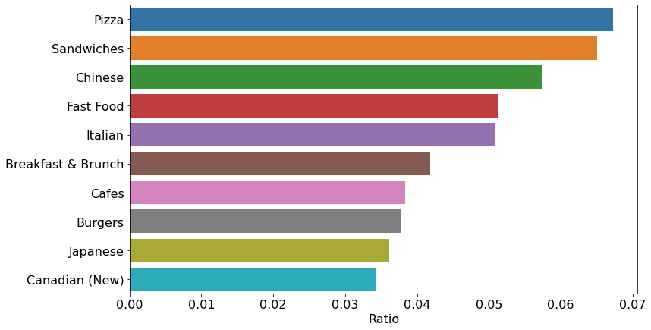
Most Common restaurant categories in Toronto area

Slide 6
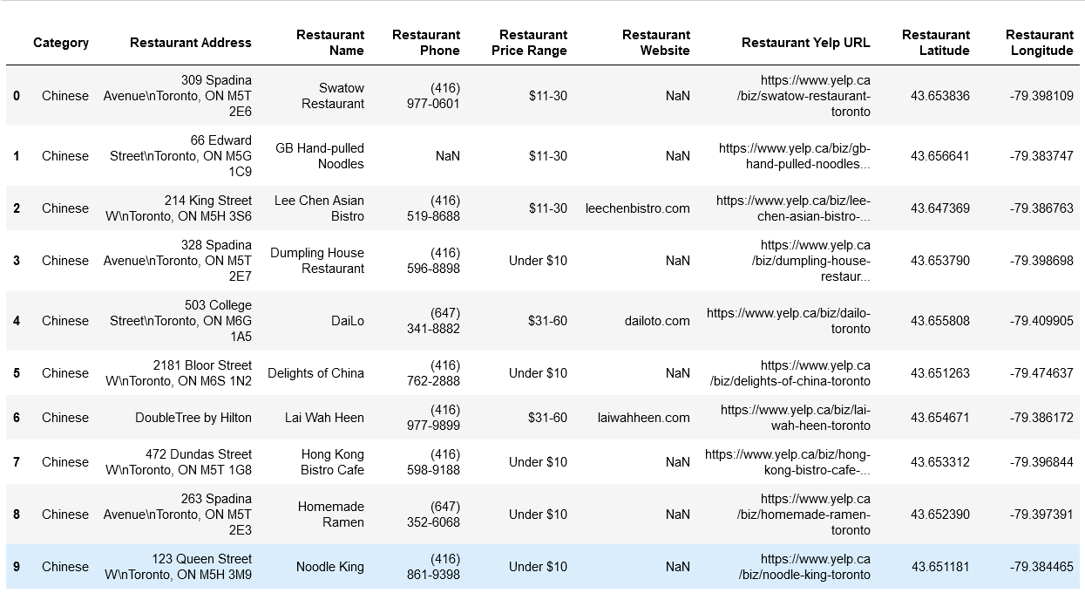
getting all Chinese restaurants

Slide 7
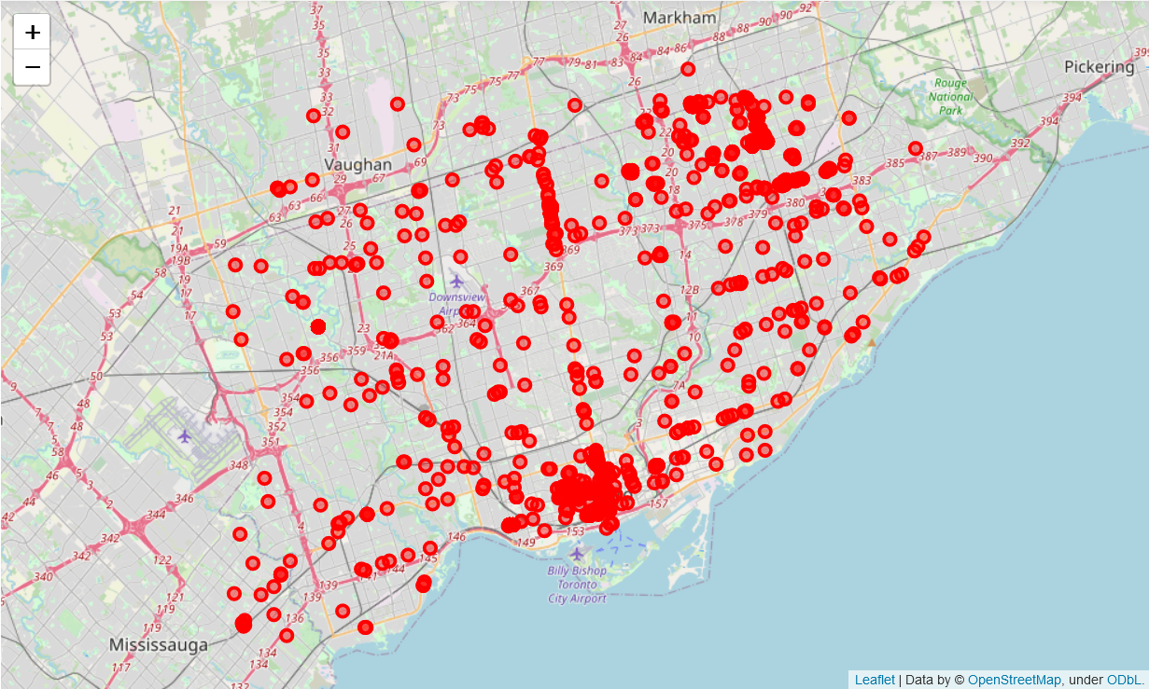
Chinese restaurants in Toronto

Slide 8
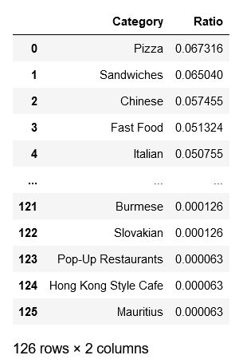
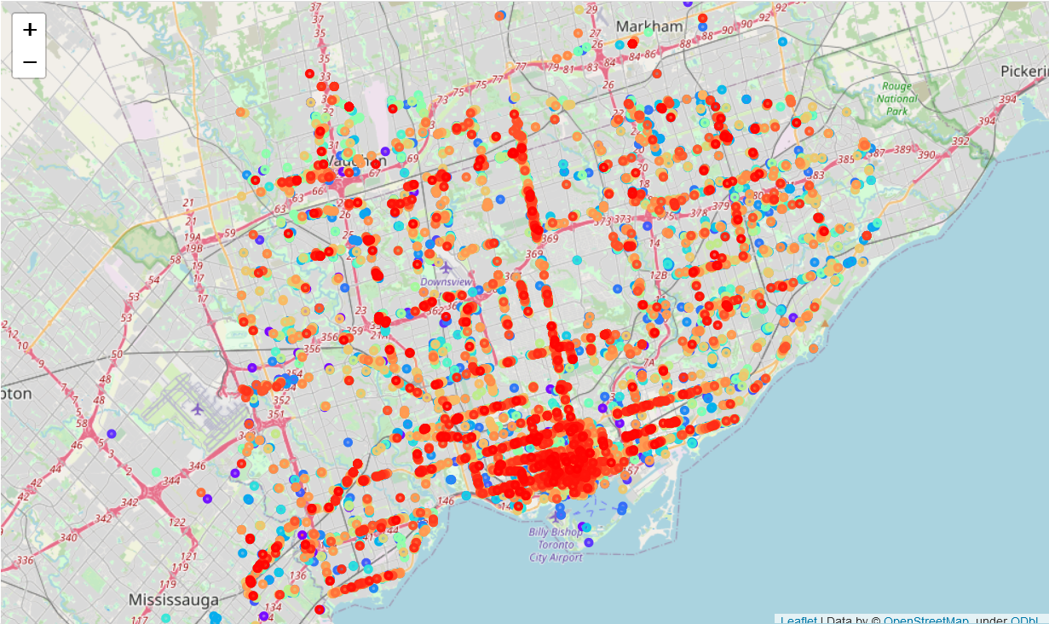
all restaurants in Toronto area

Slide 9
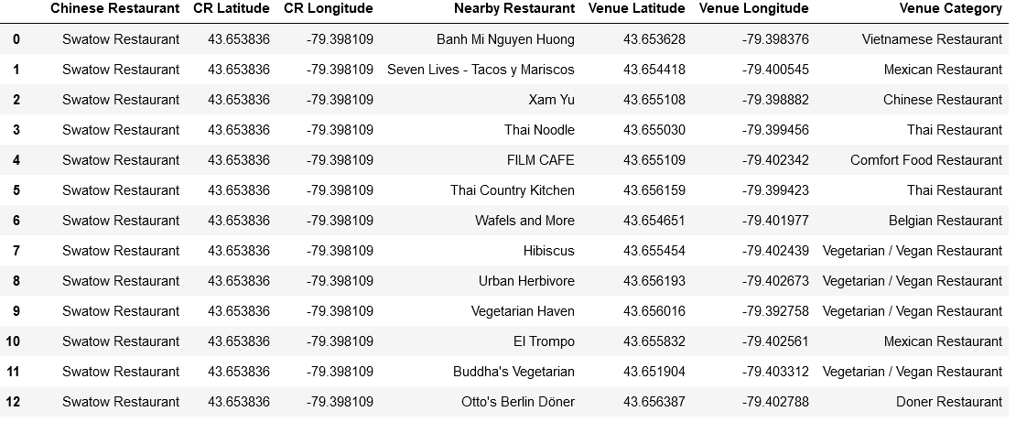
getting the restaurants within 500-meter radius of Chinese restaurants using Foursquare API

Slide 10
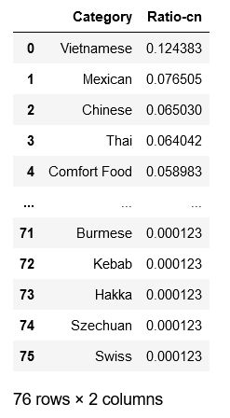
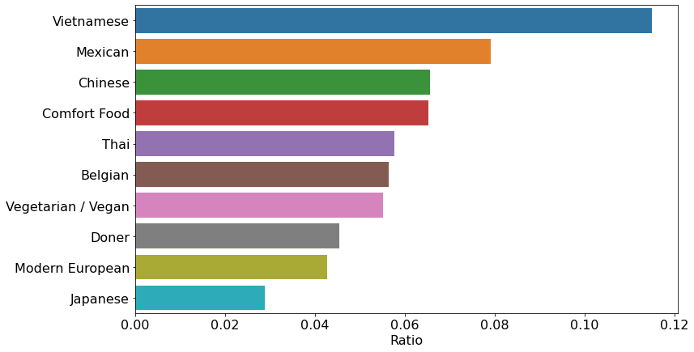
restaurants near Chinese restaurants

Slide 11
comparisons and exploration
Toronto Area
in proximity of Chinese restaurants

Slide 12
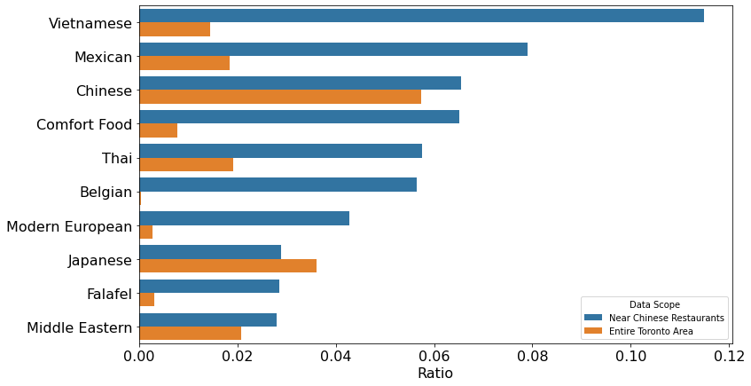
exploratory study

Slide 13
Conclusions
The restaurant types near Chinese restaurants are different from the statistics for the entire Toronto area.
The top three choices of opening a restaurant in the proximity of Chinese restaurants are: Vietnamese, Mexican, and Chinese.

